Slide 1
Lesson 1: Introduction and General Sequencing Information
Jaehyun Lee

Slide 2
Topics
What you can expect from this course
General ideas and pipelines behind transcriptomics
Sequencing technicalities and pitfalls
QC metrics for sequencing
„Mindset“ in NGS analysis
Summary

Slide 3
1. What you can expect from this course
Basic and Intermediate knowledge about transcriptional analysis
Methods
Pitfalls
How to interpret results
What is possible, what not?
How to „think“ like a Bioinformatician
Afterwards you should be able to:
Follow 80-90% of any bioinformatic analysis talk
Know which points to emphasize and which ones to „ignore“
Design and suggest experiments supported by bioinformatics
Know how and where to search for answers
What this course will not help you do:
Practical coding
Full stack bioinformatician
Everything there is to know about Bioinformatics

Slide 4
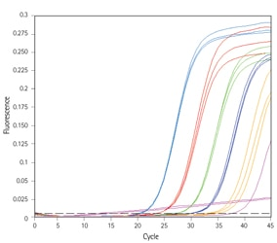
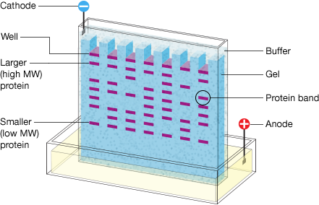
2. General Ideas and Pipelines behind transcriptomics
mRNA
Protein
Quantification of gene and protein levels were always a field of interest
The need for more:
Exhaustive analysis
Sensitive analysis
Accurate analysis
Detailed analysis
qPCR (2004)
Western Blot (1979)
Next Generation Sequencing (NGS)
Exhaustive analysis
Sensitive analysis
Accuracy and Detail depend on the technology and analysis quality

Slide 5


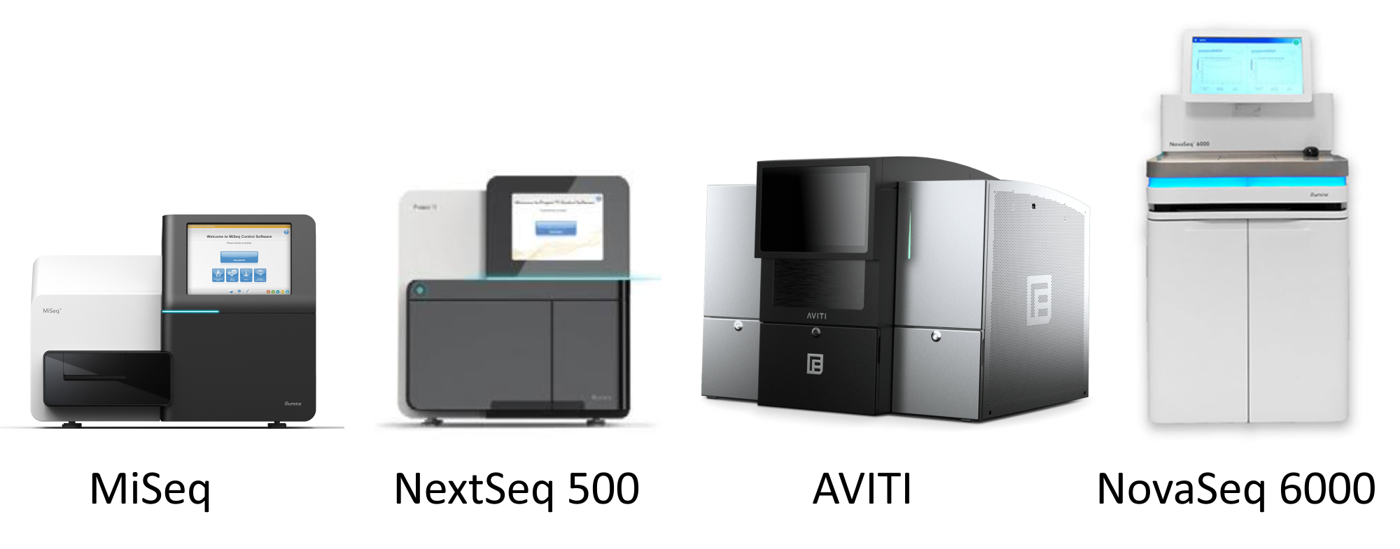
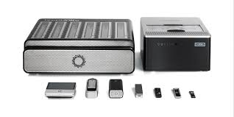
2. General Ideas and Pipelines behind transcriptomics
Rough Pipeline of NGS (for Transcriptomics);
Width of boxes represent importance and duration
Sample pre-processing
Library Preparation
Sequencing
Bioinformatics Analysis
Design of experiment
Preparing samples (growing cells, collecting blood…)
Extraction of RNA
…
Synthesis of cDNA
cDNA fragmentation
Adapter Ligation
Library construction (PCR)
…
PE150
Shotgun
WGS
…
Mapping
Analysis
For each step there are many providers and technologies -> Many Variations
Especially for the sequencing, which also heavily affects Library preparation
Illumina was used in ~90% of all sequencing data (2023)
‹#›
Notes:
Most popular NGS technologies article from 2023: https://www.sapiosciences.com/blog/a-guide-to-popular-ngs-sequencing-instruments/

Slide 6
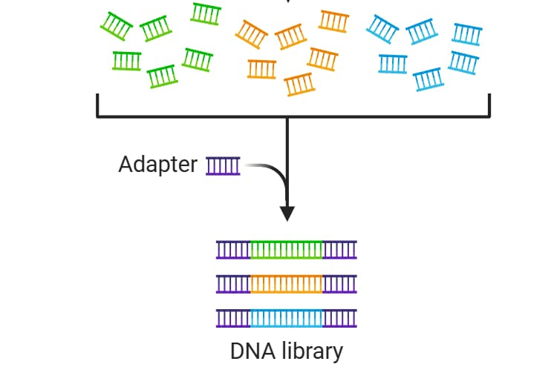
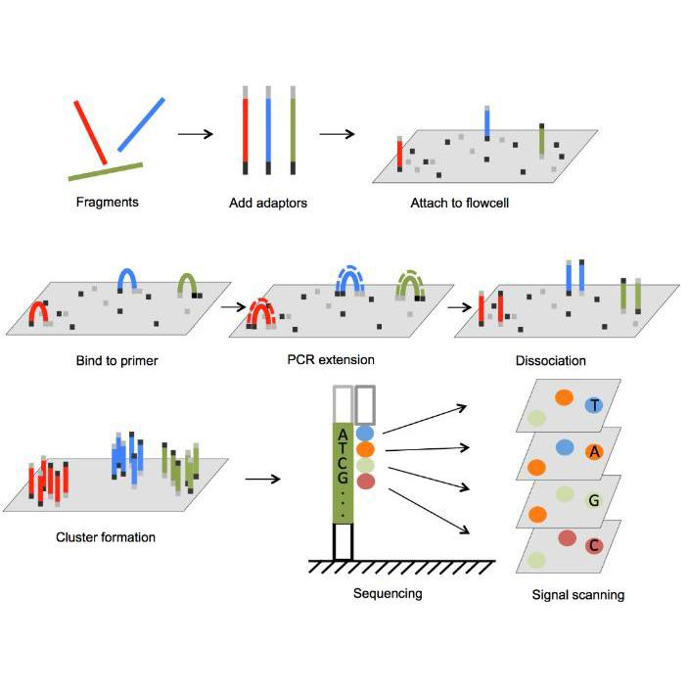
2. General Ideas and Pipelines behind transcriptomics
Example illumina Sequencing
Sample pre-processing
Library Preparation
Sequencing
Bioinformatics Analysis
Synthesis of cDNA
cDNA fragmentation
Adapter Ligation
Library construction (PCR)
…
cDNA fragmentation
Library Construction
Adapter Ligation
‹#›

Slide 7
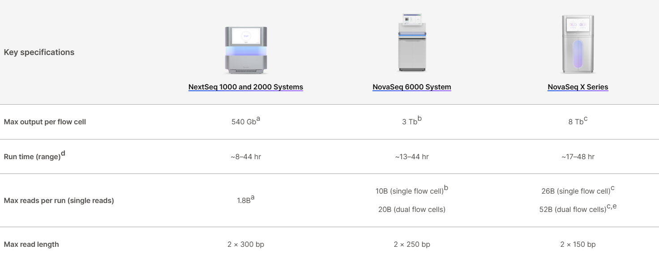
2. General Ideas and Pipelines behind transcriptomics
Example illumina Sequencing
Sample pre-processing
Library Preparation
Sequencing
Bioinformatics Analysis
PE150
Shotgun
WGS
…
‹#›
Notes:
Video explaining illumina sequencing: https://www.youtube.com/watch?v=fCd6B5HRaZ8

Slide 8
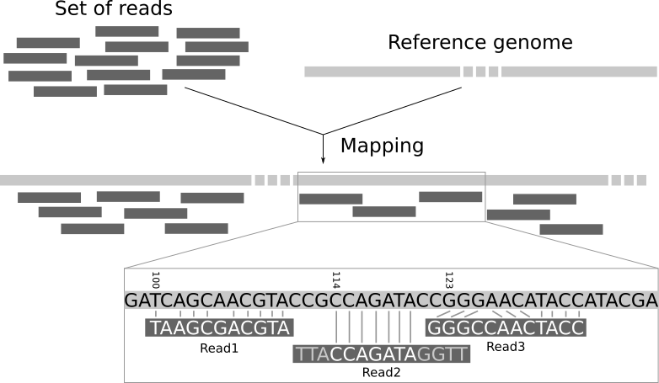
2. General Ideas and Pipelines behind transcriptomics
Example illumina Sequencing
Sample pre-processing
Library Preparation
Sequencing
Bioinformatics Analysis
Mapping to reference genome
This is a huge field that was the largest field in the „old“ bioinformatics
Methods can get pretty complex and mathematical to understand
Nowadays most people just use STAR or software have already integrated a mapping algorithm
This is something where you can confidently say: „I have used STAR but have not looked into detail of other methods.“
‹#›
Notes:
Video explaining BWA mapping: https://www.youtube.com/watch?v=1wcFavYt6uU

Slide 9
3. Sequencing technicalities and pitfalls
Some definitions:
nUMI = nCounts = reads: One sequence
nGene = nFeatures: number of unique genes detected
Errors: Sequencer assigns a wrong base during sequencing
Technical artifacts/Technical effects: Sequencing was performed without errors but technical effects like sample quality causes non-biological artifacts
‹#›

Slide 10
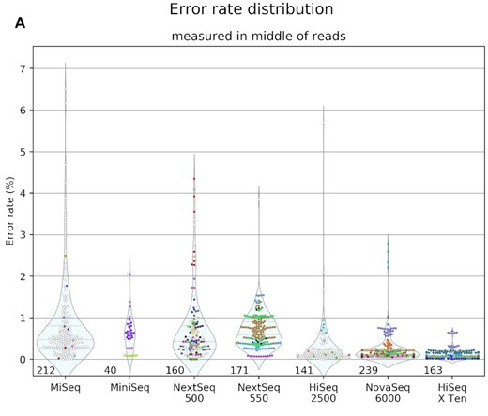
3. Sequencing technicalities and pitfalls
Sequencing will have errors!
The longer one read is, the higher the chances for errors
Errors tend to affect same genes -> Even little errors can have a huge impact
The more detailed you go, the higher the effect through errors!
Technical effects and errors tend to amplify each other
‹#›
Notes:
Paper about sequencing error profiles 2021: https://academic.oup.com/nargab/article/3/1/lqab019/6193612#442690225

Slide 11
3. Sequencing technicalities and pitfalls
Most common pitfalls
Sample pre-processing
Library Preparation
Sequencing
Bioinformatics Analysis
High difference in sample quality (like RIN values)
Contamination
Degradation
Individual handling
Day-to-Day differences
…
PCR errors
Degradation
Old buffers/solutions
Broken adaptors
Excessive damage through fragmentation
…
Sequencing errors
Sequencing saturation
Mapping errors
Biases of mapping algorithm
Biases of genomic reference
What can you do?
Sample pre-processing
Library Preparation
Sequencing
Bioinformatics Analysis
Protocol everything. Information can be added later to data
Try to always mix condition and control
Minimizing variation
Try smaller sample sizes first as a test run
Try to always use fresh solutions
Get help from your partner company
Try to sequence shorter reads (PE 150)
Keep some samples as backup
Verify proposed sequencing saturation
Use up to date genomic references and make sure your transgenes are represented in the genome
Check review papers for biases of genomes and algorithms
‹#›

Slide 12
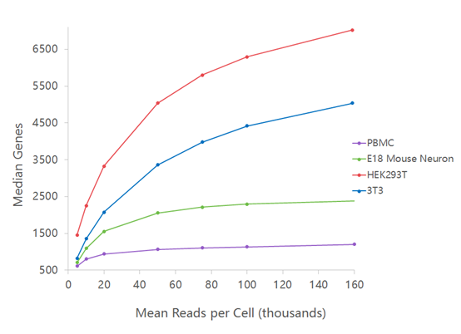
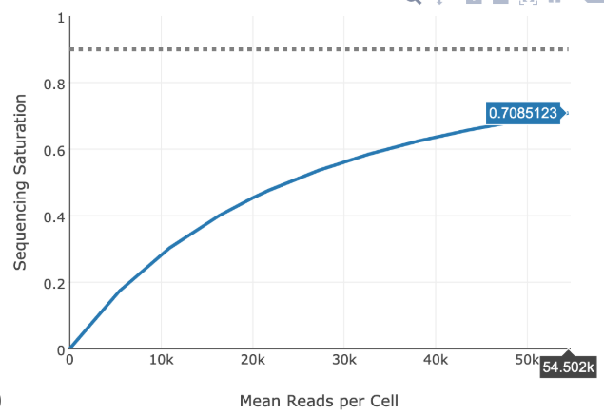
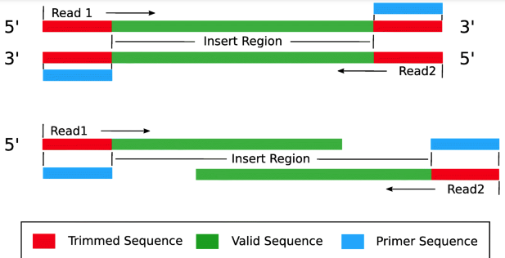
3. Sequencing technicalities and pitfalls
PE150: Paired End 150
Sequencing Saturation:
number of unique genes found in relation to number of reads
Means that one read is 150 bp long
Paired end means two 150 bp reads at each end of the cDNA fragment
With a low sequencing saturation, some rare genes might be detected in one sample but not in the other. This has the danger of it becoming detected as „differentially expressed“ and wrongly being interpreted as biological effect.
‹#›
Notes:
10X documentation how they calculate Sequencing saturation: https://kb.10xgenomics.com/hc/en-us/articles/115003646912-How-is-sequencing-saturation-calculated

Slide 13
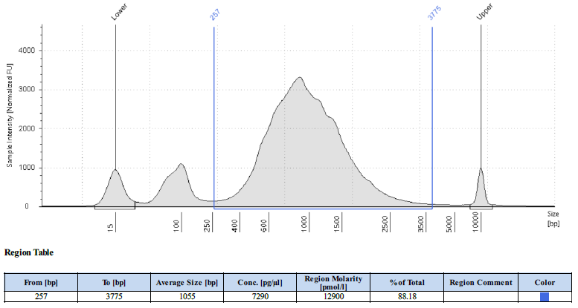
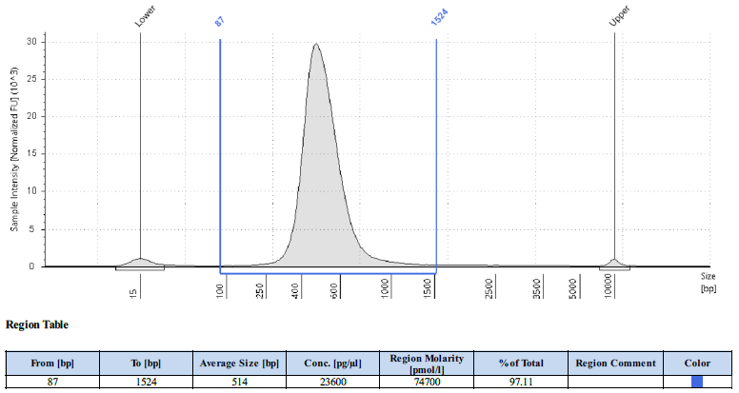
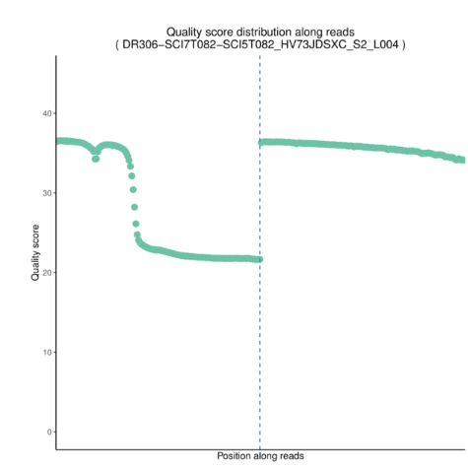
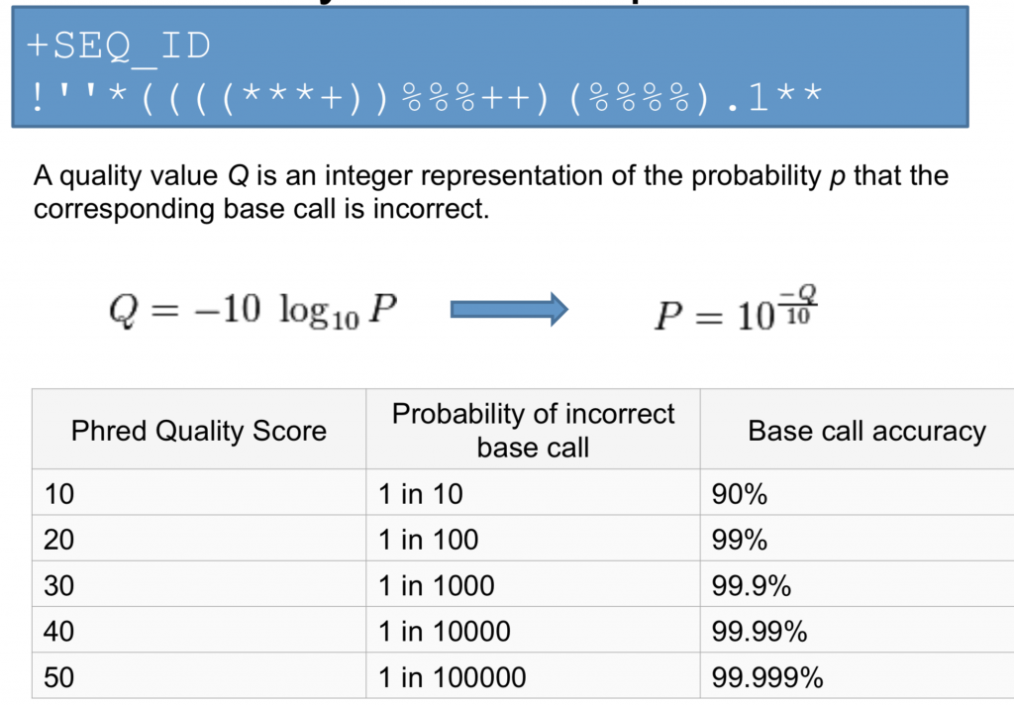
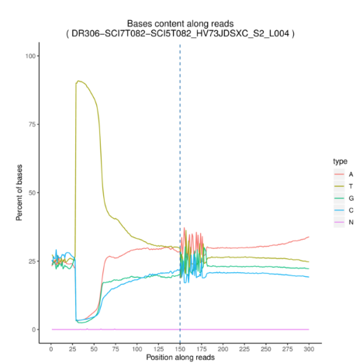
4. QC metrics for sequencing
Sample pre-processing
Library Preparation
Sequencing
Bioinformatics Analysis
RIN value
cDNA quality
Concentration
Peaks
Library quality
Concentration
Peaks
Quality score
Base content
‹#›
Notes:
Quality scores NGS analysis tutorial: https://learn.gencore.bio.nyu.edu/ngs-file-formats/quality-scores/

Slide 14
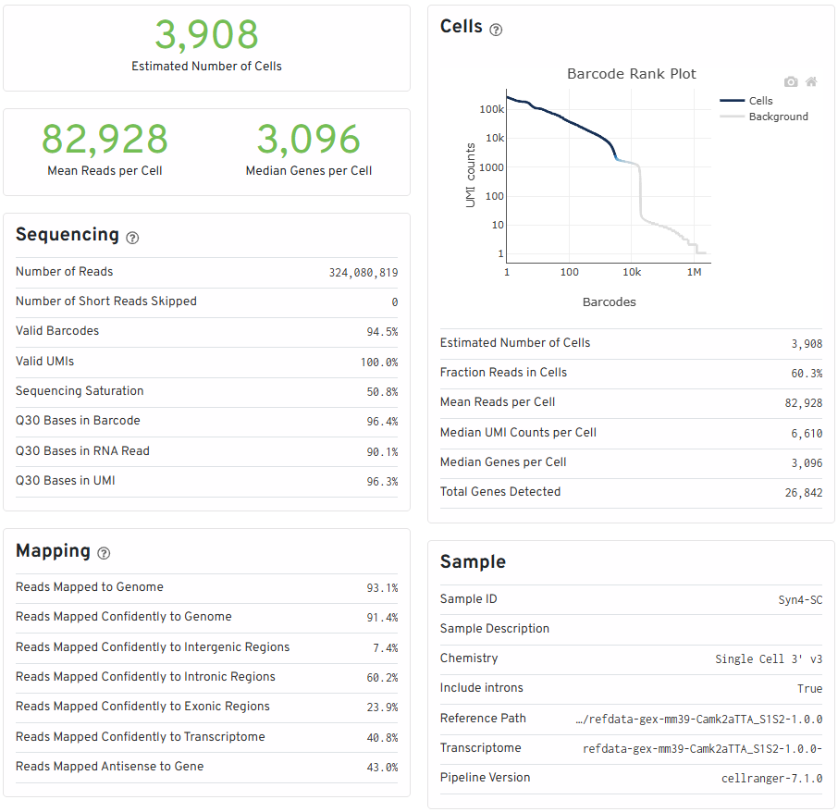
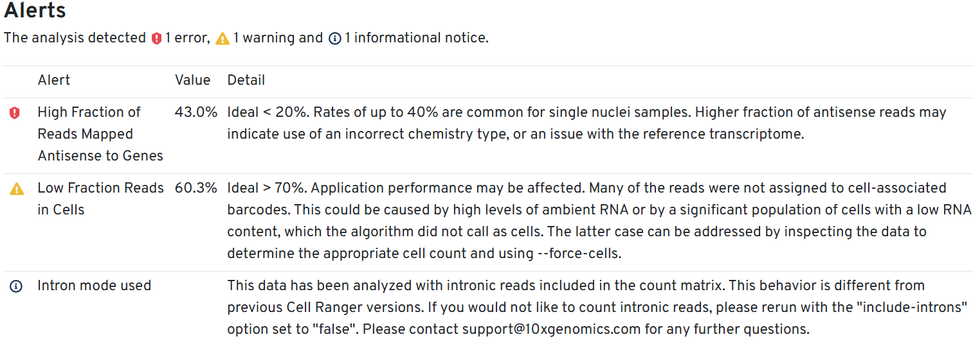
4. QC metrics for sequencing
‹#›
Notes:
Quality scores NGS analysis tutorial: https://learn.gencore.bio.nyu.edu/ngs-file-formats/quality-scores/

Slide 15
5. „Mindset“ in NGS analysis
Statistical thinking
Results, analysis etc. are never binary
Always only getting the most probable results
We always have a lack of information
Always trying to minimize unwanted effects but never 0
No „right“ way but some best practices
Quality score
nUMI, nGene, percentage mitochondria…
STAR for sequence alignment
Everything goes as long as you can argue for it
‹#›

Slide 16
6. Summary
Methods will keep getting more exhaustive, more detailed etc.
A lot of little details that is optimizable. Some are worth it
Which little details to focus on is heavily depended on methods and research question
To the point of mapping the sequences: Methods are streamlined and automated
Learn to read and understand QC reports
‹#›

Slide 17
Sources and extra
Most popular NGS technologies article from 2023: https://www.sapiosciences.com/blog/a-guide-to-popular-ngs-sequencing-instruments/
Video explaining illumina sequencing: https://www.youtube.com/watch?v=fCd6B5HRaZ8
Video explaining BWA mapping: https://www.youtube.com/watch?v=1wcFavYt6uU
Paper about sequencing error profiles 2021: https://academic.oup.com/nargab/article/3/1/lqab019/6193612#442690225
10X documentation how they calculate Sequencing saturation: https://kb.10xgenomics.com/hc/en-us/articles/115003646912-How-is-sequencing-saturation-calculated
Quality scores NGS analysis tutorial: https://learn.gencore.bio.nyu.edu/ngs-file-formats/quality-scores/
‹#›

